Slide 1
Phase 3
Final Demo:- DocBot
C+++ Group 2 Team 1

Slide 2
What was our Plan in phase 1?
Develop scalable medical AI chatbot application which can diagnose people which illness/sickness
Create a basic front end (GUI) for users to input data
Create a Chatbot that follows LEPSI
Usage of Python Language

Slide 3
Journey of development
Create a business plan
Improve coding skills
Share workload
Attend meetings
Constantly communicate

Slide 4
Vulnerabilities: Injection attacks
Malicious code
Unwillingly executing code
Command injection attack
SQL injection

Slide 5
Vulnerabilities: Data Privacy
Sensitive data
Medical History
Data breaches
Storage of user data

Slide 6
Vulnerabilities: Bot repurposing
Insecure API:
Weak authentication:
Poorly designed intent recognition:
Lack of input validation:
Insufficient testing:

Slide 7
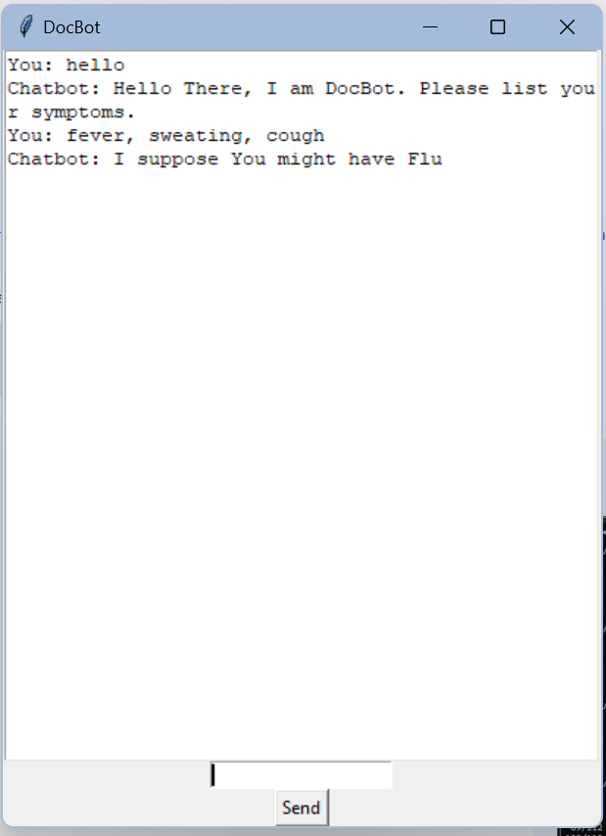
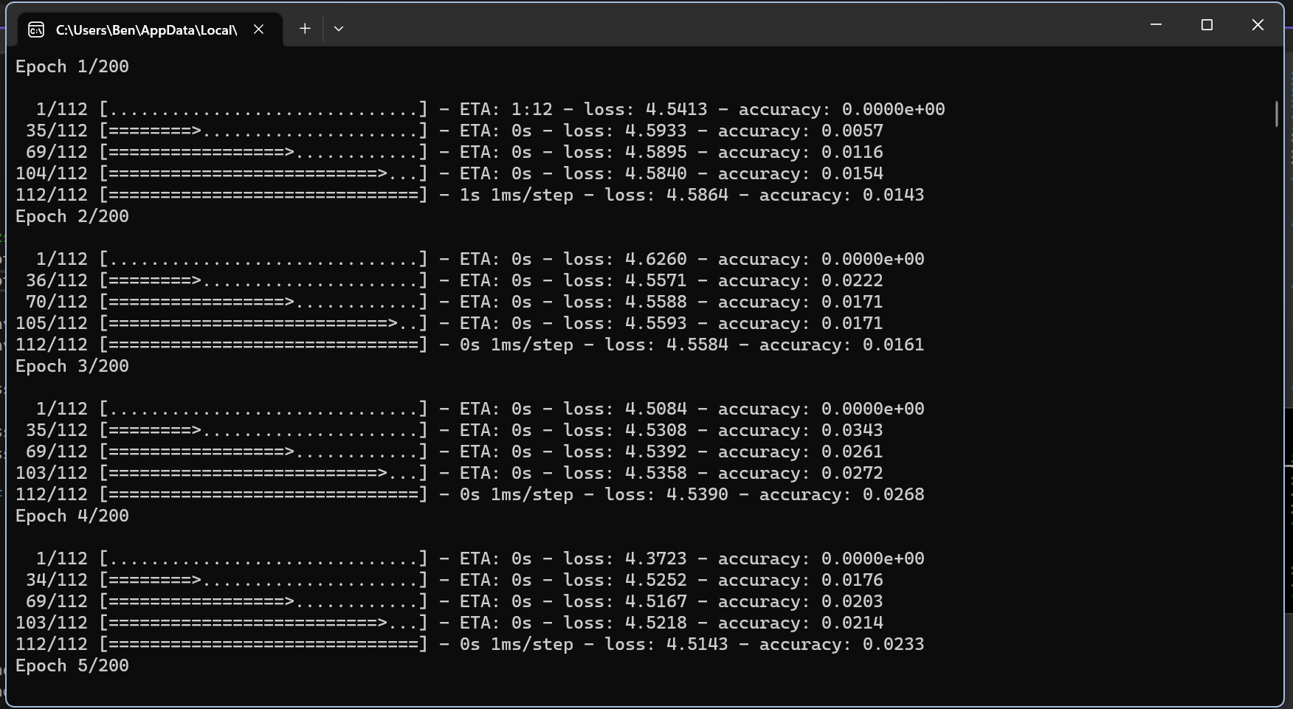
Final Application Prototype

Slide 8
DEMO

